Slide 1
Four Ways Volunteers Can Help Make Day for Saint Leo Successful
your.saintleo.edu/DayforSaintLeo

Slide 2
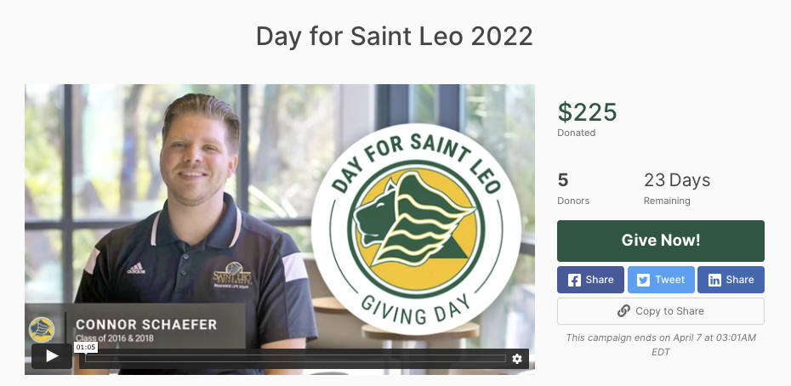
Introduction to Day for Saint Leo
The 9th Annual Day for Saint Leo is an exciting 24-hour campaign that unlocks our greatest giving potential in the shortest period of time. As the number of donors and dollars increases throughout the day, the campaign receives large donations through matching gifts from generous university supporters.

Slide 3
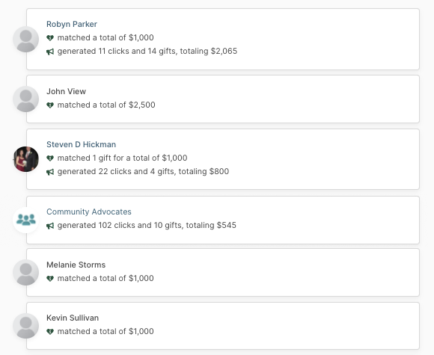
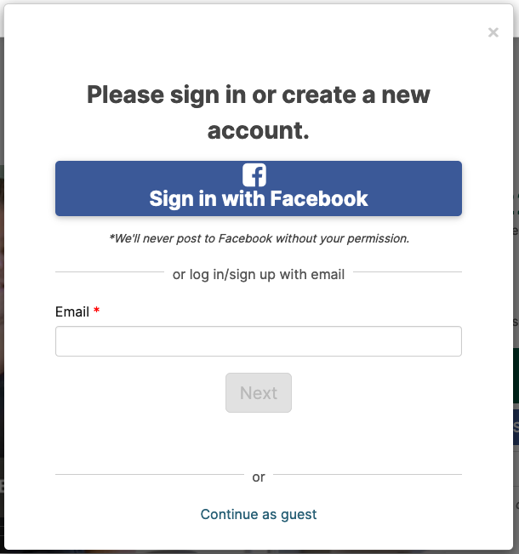
1
Sign up and become an advocate to track your impact
Why: When you share the campaign on Facebook, Twitter, or email, you will know exactly, how many clicks, gifts, and dollars your sharing is generating.
How: Visit GiveCampus.com and click ”Sign Up”. You can use your Facebook account or email. If you already have an account, click “Login”.

Slide 4
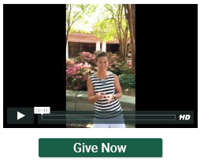
2
Create a personal plea video
Upload a video and use your own words to explain why this campaign is important to you!
How: 3 Easy Steps
Record a short video
Tell your friends why you’re supporting this campaign and why they should, too.
Upload your video
After you upload the video, you’ll receive a link to share.
Share!
Share the link with your friends and inspire them to make a gift.

Slide 5
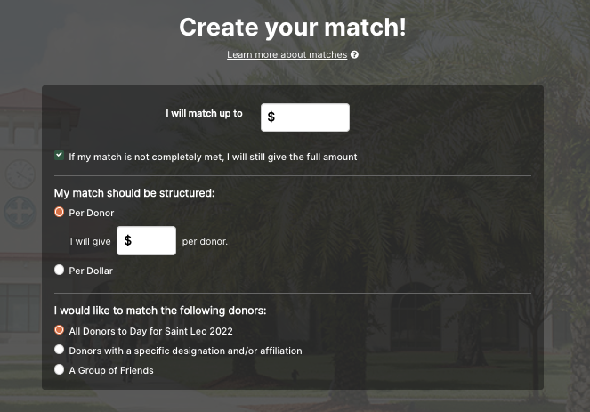
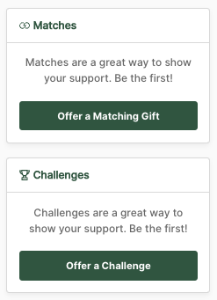
3
Offer a matching gift or challenge
Motivate others to give by creating your very own matching donation or challenge.
How: On the campaign page, click on “Offer a Matching Donation” or “Offer a Challenge” on the sidebar below the video.

Slide 6
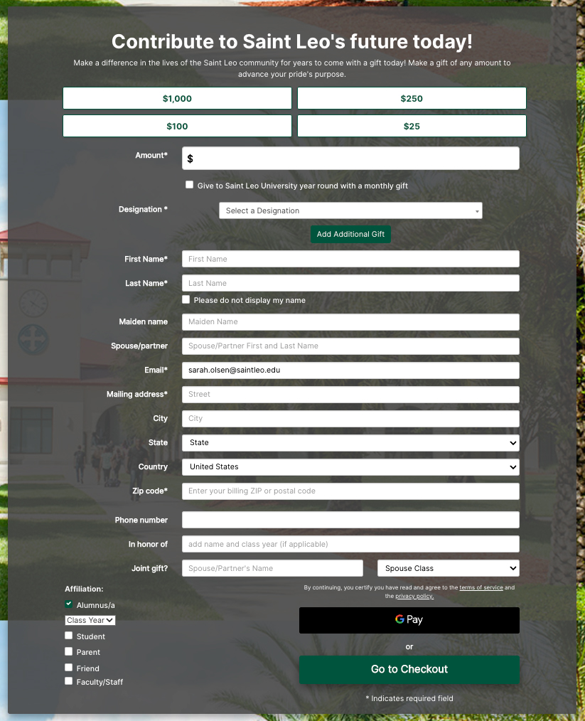
4
Make a gift!
Lead by example and make a donation of any size.
Gifts can be made by credit card, debit card, and by bank account.

Slide 7
Recap of the Four Ways You Can Help Make Day for Saint Leo Successful
Become an advocate and track your impact
Create a personal plea video
Offer a match or challenge
Make a gift!
1
2
3
4
Questions? Email engagement.giving@saintleo.edu

